Slide 1
Lesson 5 Hands-On
By Alexander Olvera

Slide 2
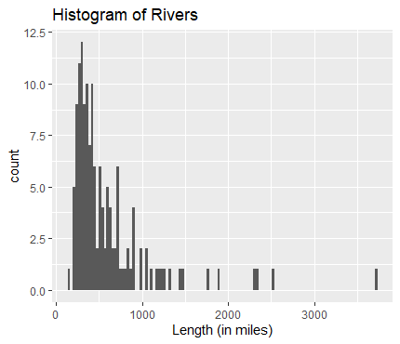
Histogram

Slide 3
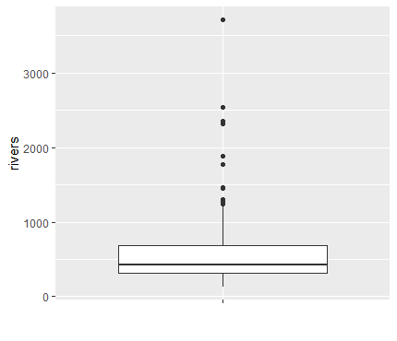
Boxplot

Slide 4
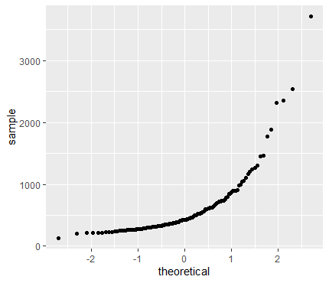
Normal Plot

Slide 5
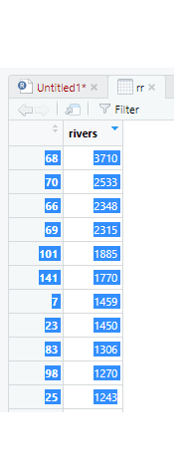
Homework Question 1
Are there any outliers in this data set? Are they high or low outliers?
Yes, first we will calculate any data 1.5 times higher or lower than the value of the interquartile range (IQR). IQR is the 3rd Quartile minus 1st Quartile (680.0 - 310.0 = 370 ---> (1.5 * 370 = 555). Next we will add this value to the third quartile to find upper outliers: (680 + 555 = 1235), and subtract it from the first quartile to find the lower outliers: (310 – 555 = -245). Values higher than 1235 and lower than –245 will be considered outliers. Note that the left column of numbers shows the rivers name and the right column is the rivers length in miles.

Slide 6
Homework Question 2
Do these data appear to come from a normal distribution?
Despite the outliers trend on the normal distribution plot, the data does show a normal distribution.

Slide 7
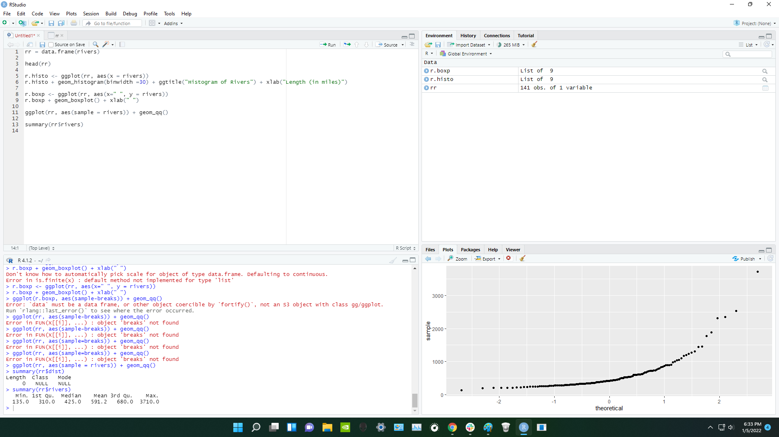
Screenshot of code and environment

